Slide 1
ANALYZING Customer purchase behaviour
KUPPUSAMY P
12/12/24

Slide 2
Aim of the project:
"To analyze customer purchase behaviour using Python.
Identify key trends and patterns, and provide data-driven insights to enhance decision-making.
Marketing, sales, and customer retention strategies.

Slide 3
INTRODUCTION:
Objective:
Why analyze customer purchase behavior?
Understand customer preferences
Improve marketing strategies
Increase sales and customer retention

Slide 4
FUNCTIONALITY:
Customer ID:
Unique identifier for each customer.
Age
Income
Product Category
Total Spend
Purchase Frequency
Location

Slide 5
Data Preprocessing:
Handling missing values
Removing duplicate
Data cleaning
Calculate IQR for ‘Total spend’
Tools Used: Pandas, NumPy

Slide 6
VISUALIZATIONS:
Bar charts
Histograms
Line charts using Matplotlib or Seaborn
Boxplot
Correlation Heatmap

Slide 7
STATISTICAL ANALYSIS:
Descriptive Statistics
Summarization and presentation of data.
Hypothesis Testing
Hypothesis testing is a statistical method used to evaluate evidence.
Regression Analysis
Used to model and analyze the relationship.

Slide 8
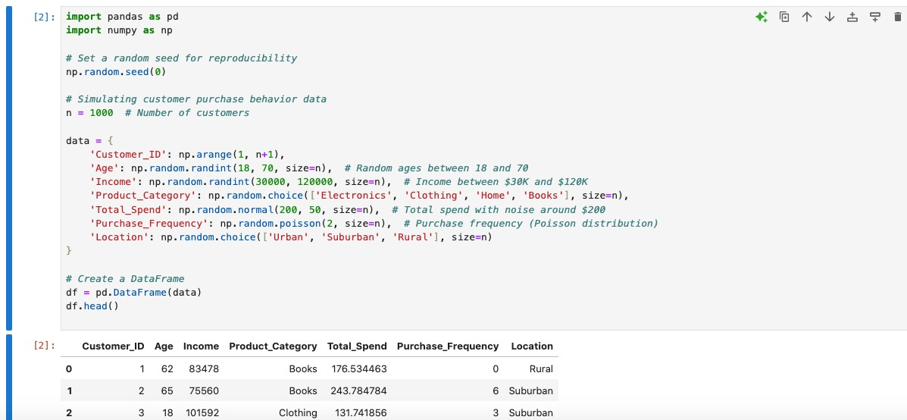
CODE SNIPPET:

Slide 9
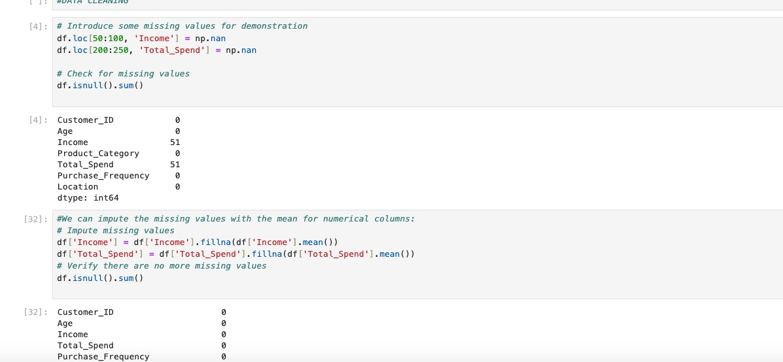
CODE SNIPPET:

Slide 10
CHALLENGES:
Data quality and privacy concerns.
Changing customer preference.
Integration of data from multiple source

Slide 11
CONCLUSION:
Summary of finding.
Benefits of understanding purchase behaviour.
Next steps for implementation

Slide 12
THANK YOU

